Slide 1


Social Buzz
Data analysis

Slide 2


Today's agenda
Project recap
Problem
The Analytics team
Process
Insights
Summary

Slide 3

Social Buzz is a fastest growing technology unicorn,
Client need to insights of data and proper analysis for taking a accurate decision for company.
Accenture has taken the task and will providing the data analysis.
There are three major task:
1)An audit of their big data practice.
2)Recommendation for successful IPO.
3)Analysis the data and find the top 5 categories content.
Project Recap

Slide 4


Problem
Over 100000 posts per day.
36,500,000 piece of content every year.
Analysis to find the most popular categories

Slide 5



The Analytics team

Slide 6
Process
1
Data Understanding
2
Data cleaning
3
Data Modelling
4
Data Analysis
5
Uncover Insights

Slide 7

Insights from the data
Healthy Eating is top most category
16 unique categories

Slide 8
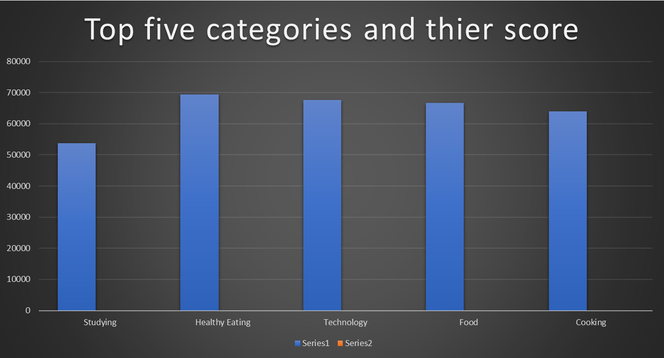

Slide 9

Social Buzz data analysis
Top 5 categories:
1)Studying
2)Healthy Eating
3)Technology
4)Food
5)Eating
Insights:
Photos are posted most on social buzz
Studying and Healthy Eating top categories it means people like the content about studying and they also care about health.
Summary

Slide 10

Thank you!
ANY QUESTIONS?

